Slide 1
PROJECT DEVELOPMENT PHASE PROJECT DEVELOPMENT PHASE PROJECT DEVELOPMENT PHASE DEVELOPMENT OF SPRINT – 01
DATE | 29th OCTOBER 2022
TEAM ID | PNT2022TMID30005
PROJECT TITLE | ANALYSIS OF CROP YIELD PREDICTION USING DATA MINING TECHNIQUES

Slide 2
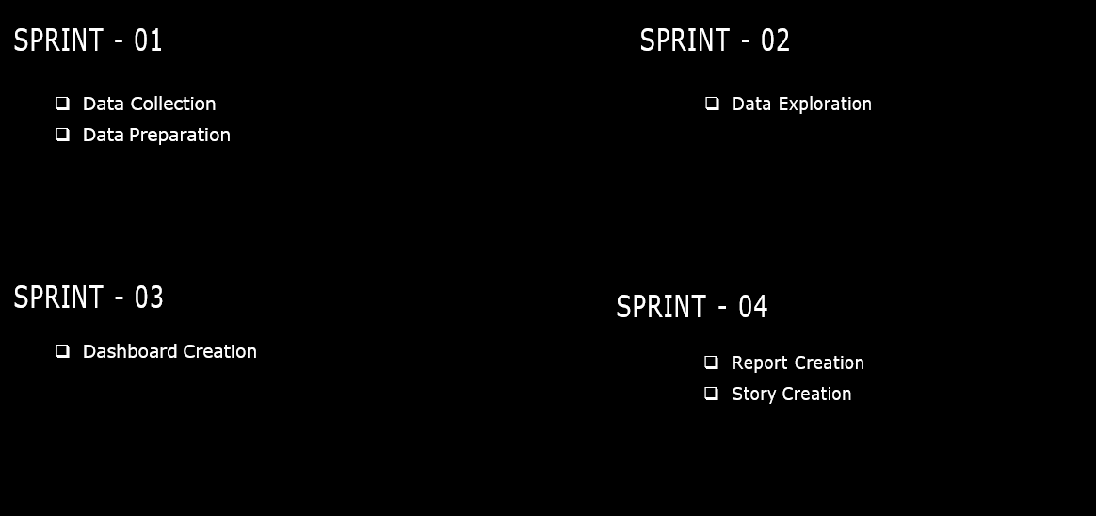

Slide 3
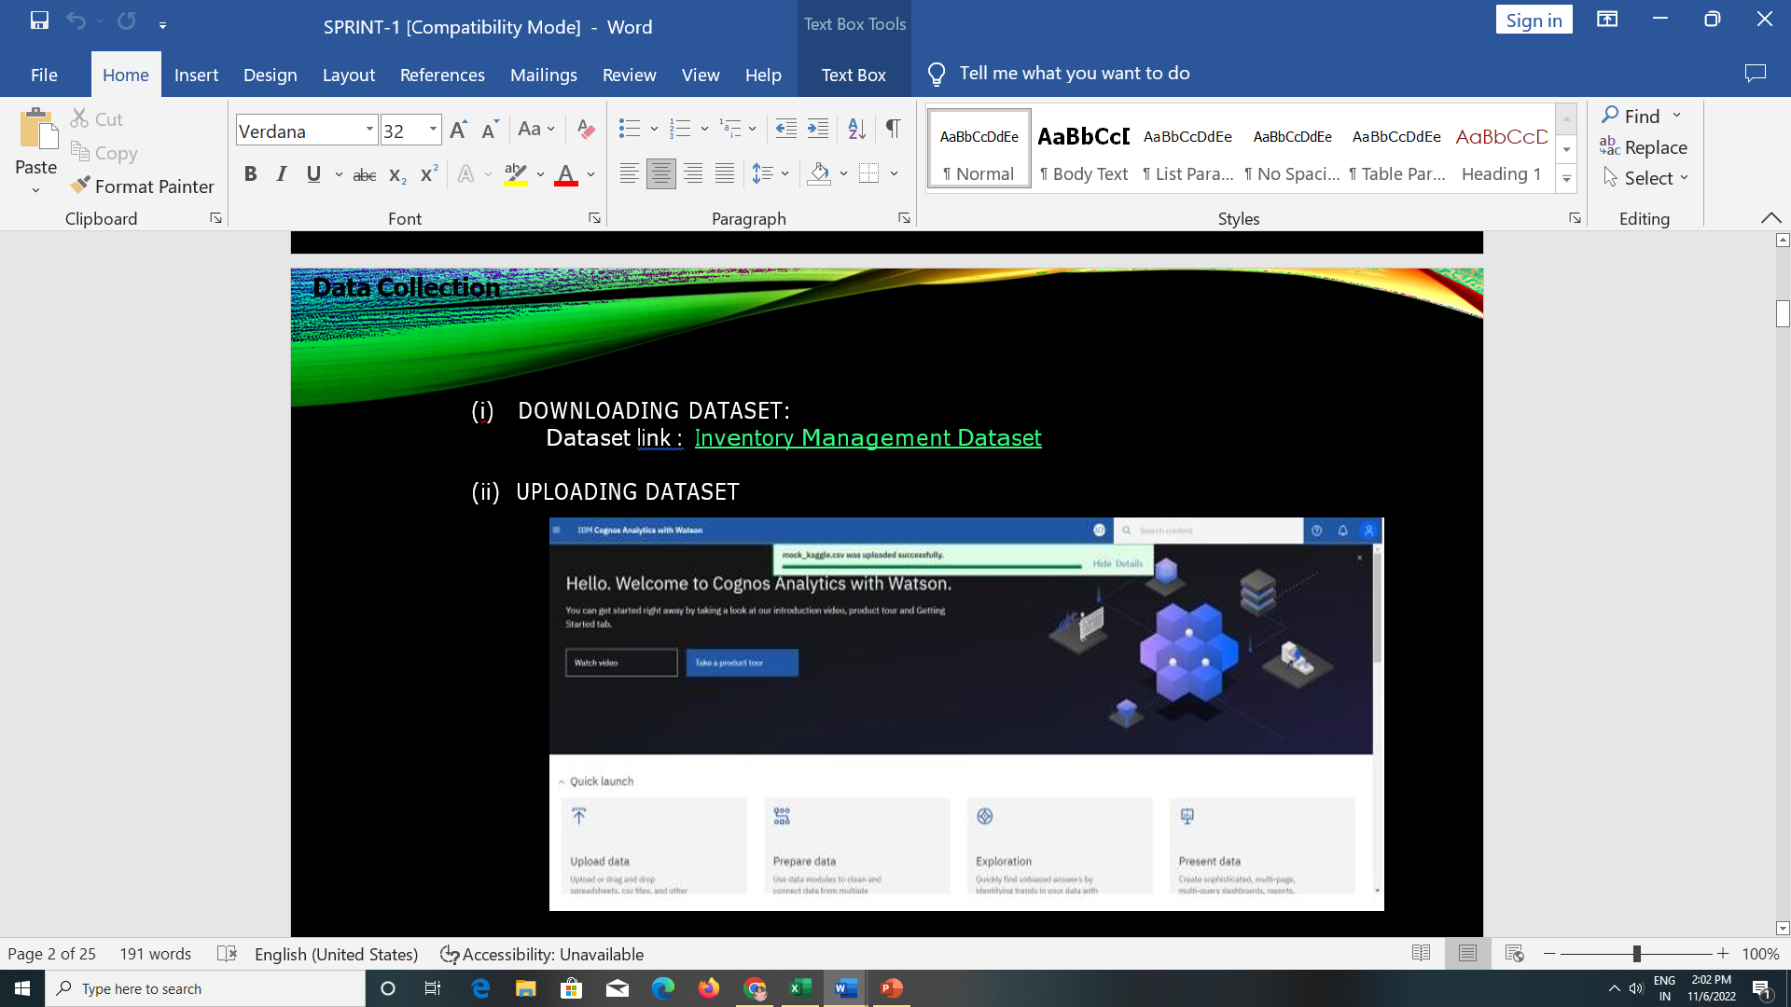
1) DOWNLOAD DATASETS: http://www.fao.org/home/en/
2) UPLOADING DATASETS

Slide 4
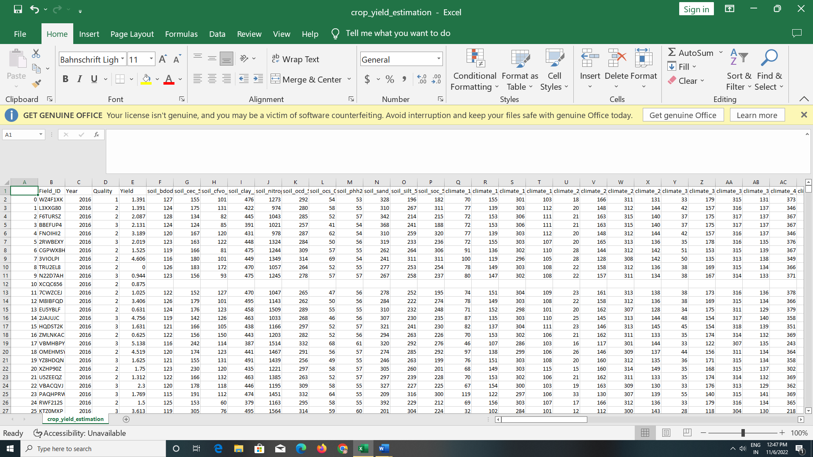
DATA PREPARATION Prepare the datasets

Slide 5
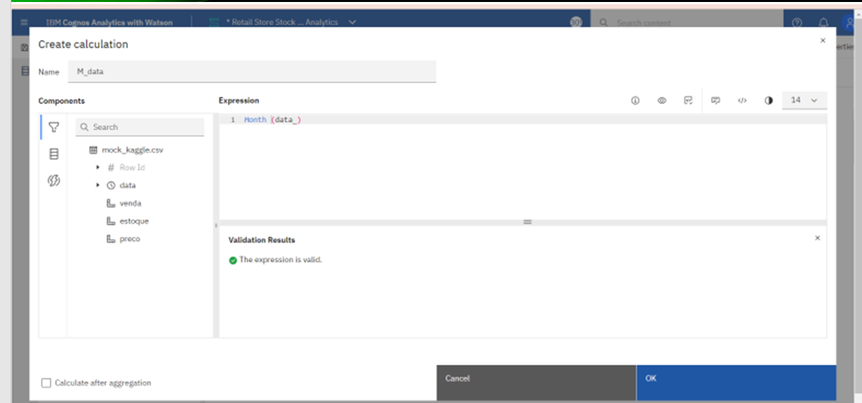
MONTH DATA

Slide 6
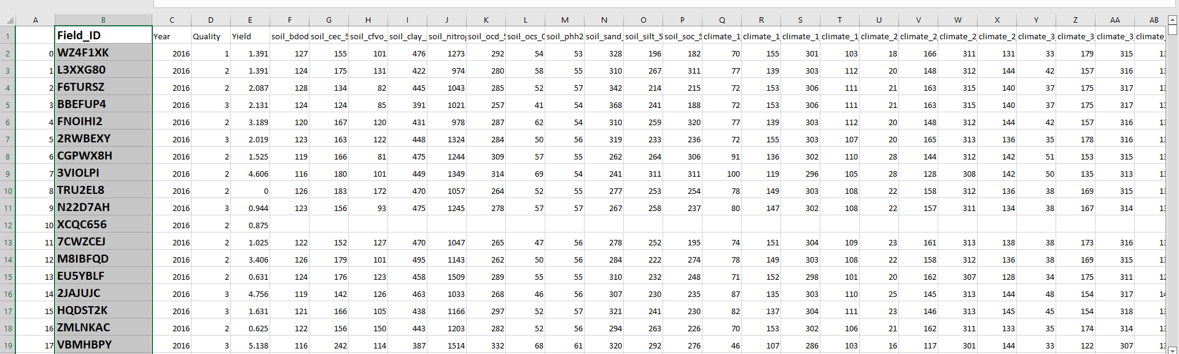
FIELD ID

Slide 7
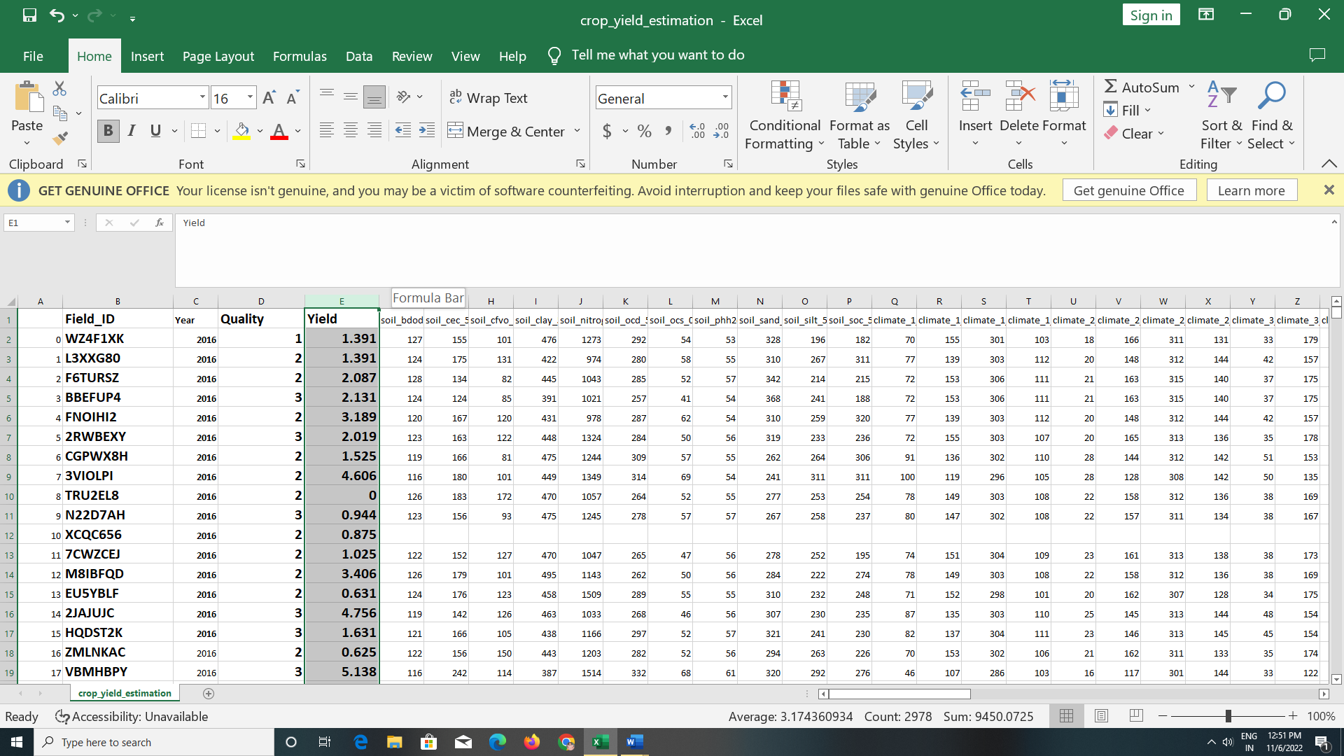
YIELD

Slide 8
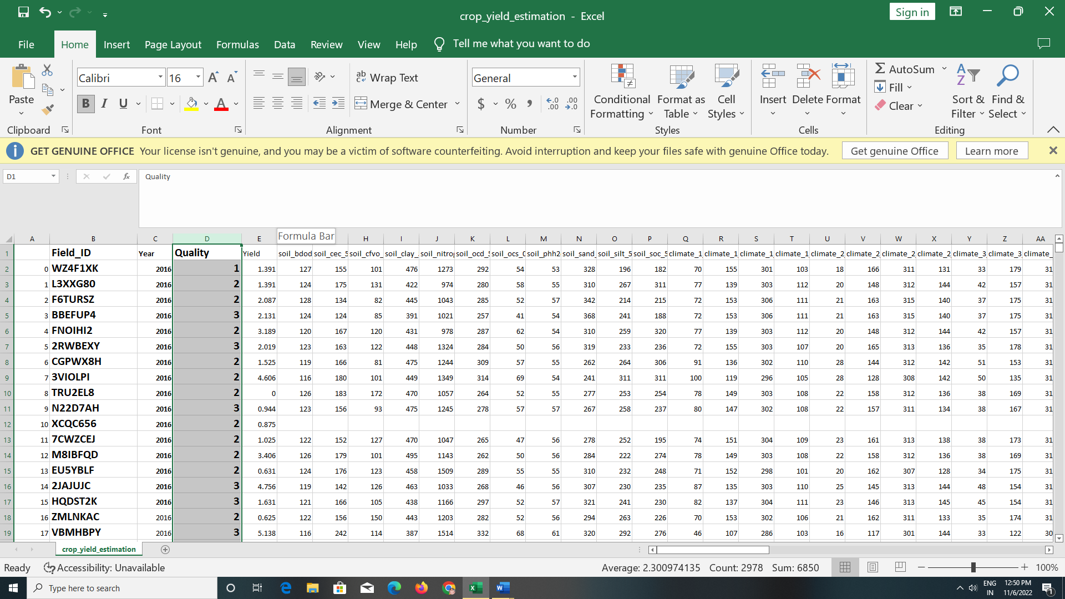
QUALITY

Slide 9
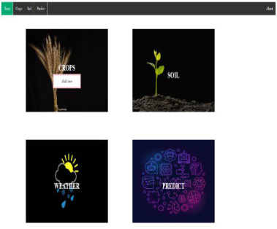
DATA COLLECTIONS

Slide 10
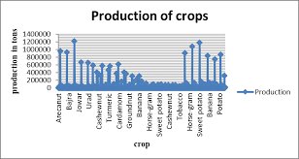
PRODUCTION OF CROPS

Slide 11
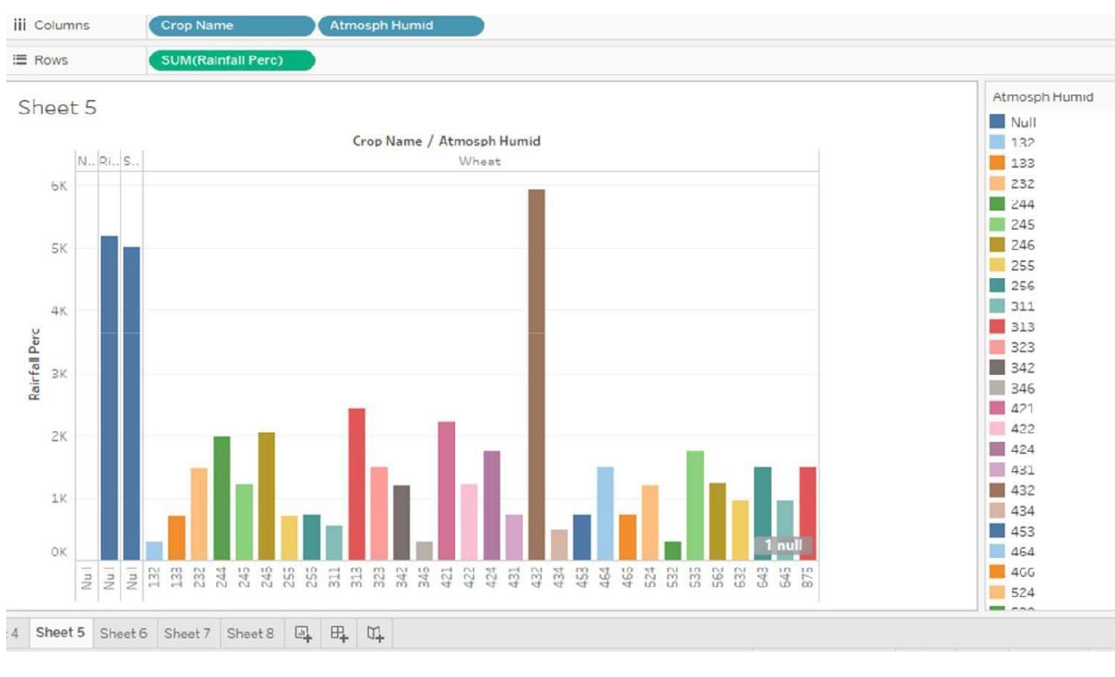
ANALYSIS

Slide 12
